Slide 1
2022-2024
All NBA Team Predictor
2023 UTSA Data Analytics Bootcamp
1

Slide 2
Group 3 Team members
Alex Chavera
Roel De Los Santos
Armando Magallan Jr.
Jerrod Williams
2

Slide 3
What is the All-NBA Team?
The All-NBA team is a honor given to the best players in the National Basketball Association
The players are selected by a global panel consisting of sportswriters, broadcasters, and pundits
This team has been selected every season, and has consisted of first, second, and third teams
Each team is comprised of 2 guards, 2 forwards, and 1 center
The All-NBA team started in 1946 with the league’s conception, and continues to be an annual honor given to this day
In 1988, the format of the All-NBA team switched from 2 selected teams to 3 total selected teams. This would make 15 total players selected for the current All-NBA team
3

Slide 4
Project Goal and Objective
Create a machine learning model to predict the 2023-2024 All-NBA Team using jupyter notebook
Identify the top 15 players that would be selected for the three All-NBA Teams
Use combined historical data from the 2022-2023 NBA season and current data from the 2023-2024 NBA season to Predict the 2023-2024 All-NBA Team
4

Slide 5
Methodology
Data Collection will consist of comprehensive player and team statistics from the 2022-2023 NBA season as well as the 2023-2024 NBA season
Data processing will be done using Python libraries such as NumPy for data manipulation and analysis
We will also use feature selection and standardization to select relevant features and standardize using sklearn.preprocesing.StandardScaler
5

Slide 6
Necessary Tools
We will use python for data analysis and machine learning modules
Tableau will be used for data visualizations
Python For machine learning and data analysis
Python Libraries used were Pandas, NumpPy, scikit-learn.SQL
6

Slide 7
Data Cleansing
Took 2 CSVs sourced from basketballref.com from the 2022-2023 and 2023-2024 season
First thing Alex did was merge the two CSVs together using pandas
We then cleaned data and added and removed necessary columns using jupyter notebook
Next, he calculated the probability for each player to make the All-NBA Team
Last, we narrowed the positions down to one position per player to make the data easy to read and understand
Pooled shooting guards/point guards into Guards and Power forwards/small forwards into Forwards
7

Slide 8
Final Steps, Scaling, and Testing Data Score
A logistic regression was used to train this model
After training the model, we tested our actual data from the cleaned CSV
Our training score for the model was 0.9975
Our testing data score was 0.9433
Overall, our testing data score was about 5% lower than our training one
9

Slide 9
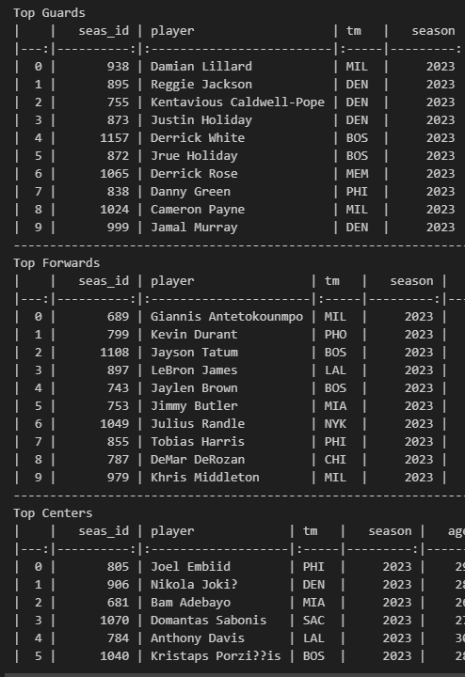
Prediction results from Machine Learning
After training our data set, we printed out the results and ordered them by ranking
Results were mostly as expected
You can clearly see the outlier results with Reggie Jackson and Kentavious Caldwell-Pope being ranked abnormally higher for being on a well performing team such as Denver(reigning champions).
Every other top ranked player consists of previously selected All-NBA team players, or top players in their respected position
8

Slide 10
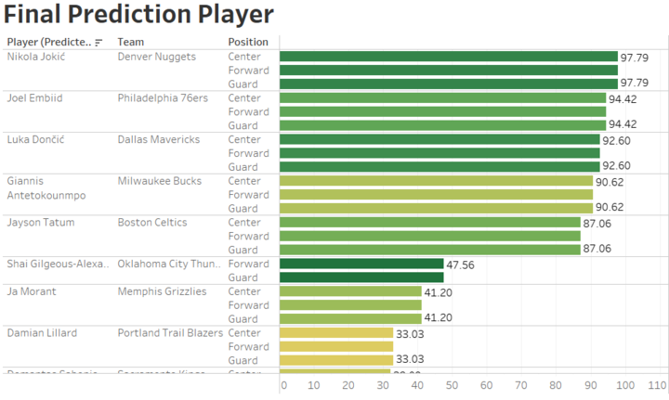
Tableau
Data Visualization done by Jerrod in Tableau to show the probabilities of each player to make the All-NBA team
As the percentage of making the team increases, the bar on the right of the visualization is longer to show the likely probability of making the team
10

Slide 11
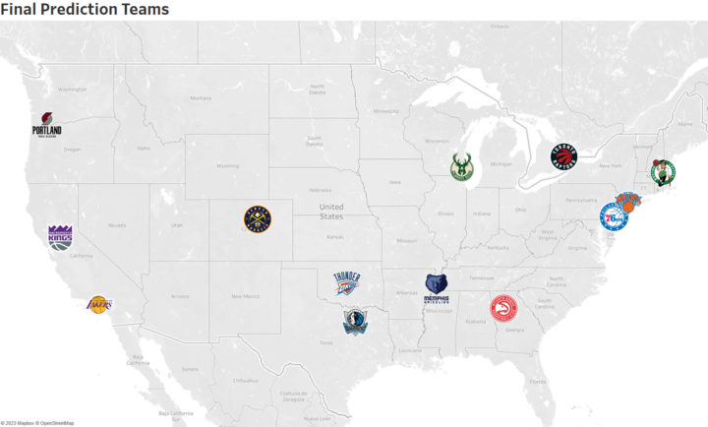
Tableau pt.2
Live demonstration of Tableau visualizations with Jerrod
https://public.tableau.com/app/profile/jerrod.williams/viz/shared/9QX9C5364

Slide 12
Possible Limitations/Takeaways of the Project
Partial Season data from the 2023-2024 season was combined with 2022-2023 historical season data. It could be more accurate to run this model with a full set of season data for the 2023-2024 season after the season concludes
More accurate machine learning testing and data cleaning of our CSV could help to avoid having outliers in our top player predictions such as the Denver Nuggets players (reigning NBA champions)
We compared our project to a similar one on Github, and yielded similar results to theirs apart from our few outliers; they had a 98% testing data score as compared to our 94% testing data score showing our need to refine our code a bit more
Teams are voted on by analysts and sports pundits, leading to human bias being a factor into the final team results

Slide 13
Useful Links regarding our project
https://www.basketball-reference.com/ for CSV files
https://public.tableau.com/app/profile/jerrod.williams/viz/shared/9QX9C5364 For Tableau Visualizations
https://github.com/EdSpiezio-Runyon/UTSA_Project_4_All_NBA_Team_Predictor/tree/main For link to the GitHub project we referenced and compared ours to

